Slide 1
Health Management System
Design and Implementation Overview
Hamprey Aganyo Ndemo
April 27, 2025

Slide 2
Introduction
This Health Information System empowers doctors to efficiently manage health programs and client data. It enables users to:
Create and manage various health programs.
Register new clients and track their health information.
Enroll clients in multiple health programs based on their needs.
Search for clients using multiple criteria.
View comprehensive client profiles, including their health program enrollments.
Expose client profile data via an API for seamless integration with other systems.

Slide 3
Project Objectives
Create and Manage Health Programs: Allow doctors to create, update, and delete health programs (e.g., TB, Malaria, HIV).
Register Clients: Enable easy registration of clients with essential personal and health information.
Enroll Clients in Programs: Provide functionality for enrolling clients in one or more health programs.
Search and Filter Clients: Implement a search system to find clients based on specific criteria (e.g., name, program, condition).
View and Manage Client Profiles: Allow doctors to view and manage detailed client profiles, including program enrollments.
Expose Client Data via API: Develop an API for secure access to client profiles by third-party systems.

Slide 4
Development Approach
Methodology: Agile development with iterative improvements.
Technologies
Backend: Django (Python)
Frontend: HTML, CSS, JavaScript
Database: SQLite (or chosen database)
Development Phases
Requirements gathering
System design
Implementation
Testing & deployment

Slide 5
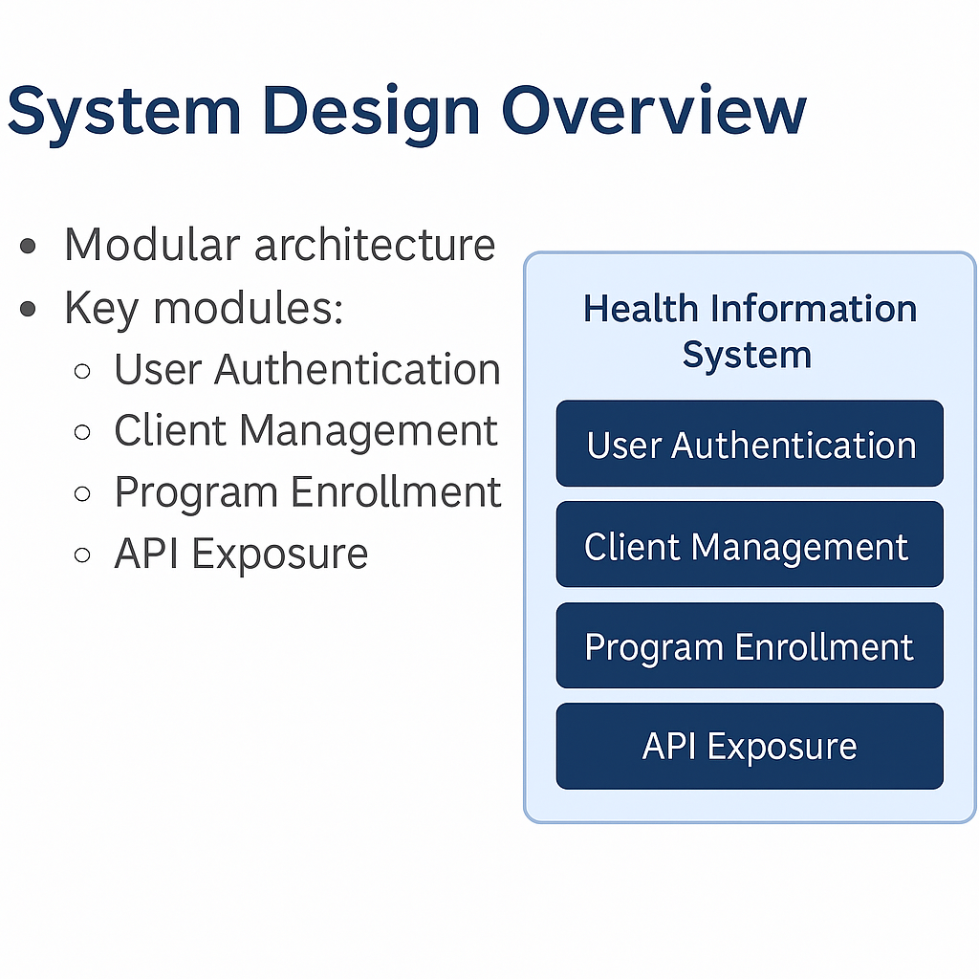
System Design Overview

Slide 6
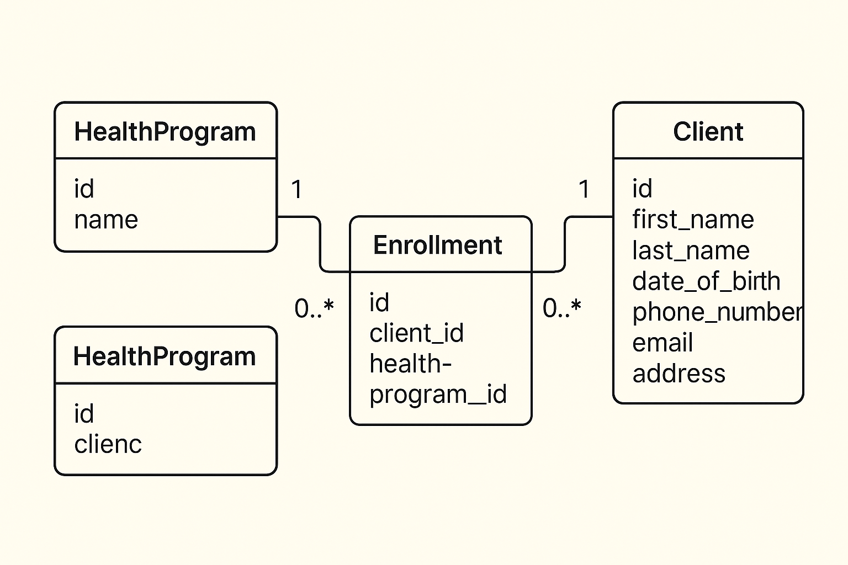
Database Design

Slide 7
Security Measures
Authentication/Authorization
Implement RBAC, MFA, and JWT or OAuth for secure login and access control.
Data Encryption
Use SSL/TLS for data in transit and AES-256 for data at rest.
API Security
Secure APIs with OAuth2 or API keys, and implement rate limiting and input validation.
Data Integrity
Maintain audit logs and implement version control for health programs and client data.
Privacy
Obtain client consent, minimize data collection, and consider anonymization/pseudonymization.
Protection Against Vulnerabilities
Mitigate XSS, CSRF, and clickjacking with input sanitization, anti-CSRF tokens, and frame busting.
Backup/Disaster Recovery
Regularly back up data and create a disaster recovery plan
doRegular Audits
Conduct security audits and penetration testing.

Slide 8
Solution Highlights
Program Management: Create, update, and manage health programs (e.g., TB, HIV, Malaria).
Client Registration & Tracking: Easy client registration and health information management.
Flexible Enrollment: Enroll clients in multiple health programs based on needs.
Search & Filtering: Advanced search by name, program, condition, etc.
Client Profiles: View detailed client profiles with health program data.
API Integration: Secure API access for third-party system integration.

Slide 9
Challenges & How They Were Overcomed
Program Management
Challenge: Handling updates without data inconsistencies.
Solution: Use version control and rollback mechanisms for smooth updates.
Client Registration & Tracking
Challenge: Ensuring data accuracy during registration.
Solution: Implement validation rules and automated data entry checks.
API Integration
Challenge: Ensuring secure and seamless third-party integration.
Solution: Use secure authentication (OAuth) and data encryption.

Slide 10
Conclusion
The Health Information System provides a streamlined and secure platform for managing health programs and client data. By enabling efficient program management, accurate client registration, flexible enrollment, and seamless API integration, the system enhances healthcare delivery. With robust security measures and optimized performance, it ensures that sensitive data remains protected while improving the overall effectiveness of healthcare operations. This system is designed to scale, integrate, and adapt to future needs, ensuring long-term reliability and success.

Slide 11
Thank You
Hamprey Aganyo Ndemo
@humphreyaganyo@gmail.com
+254 758 265178

